Slide 1
Phonepe Pulse Data Visualization and Exploration

Slide 2
AGENTA
Introduction
Tools Install
Requirement Libraries to Install
Import Libraries
Extract data
E D A Process and Framework

Slide 3
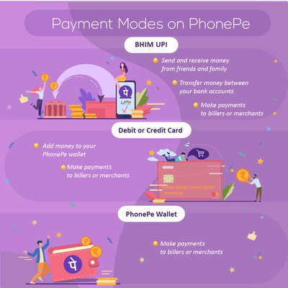
Introduction
PhonePe is an Indian digital payments and financial services
company headquartered in Bengaluru, Karnataka, India. PhonePe was
founded in December 2015. he PhonePe app, based on the Unified Payments
Interface (UPI). PhonePe is a mobile payment platform using which
you can transfer money using UPI, recharge phone numbers, pay
utility bills, etc. The company aims to make digital payments so easy, safe,
and universally accepted that people never feel the need to carry cash or
cards again.
We create a web app to analyse the Phonepe transaction and users
depending on various Years, Quarters, States, and Types of transaction and
give a Geographical and Geo visualization output based on given
requirements.

Slide 4

DEVELOPER GUIDE

Slide 5
Libraries/Modules needed for the project!
1.Tools install
1. [Plotly](https://plotly.com/python/) - (To plot and visualize the data)
2. [Pandas](https://pandas.pydata.org/docs/) - (To Create a DataFrame with the scraped data)
3. mysql.connector - (To store and retrieve the data)
4. [Streamlit](https://docs.streamlit.io/library/api-reference) - (To Create Graphical user Interface)
5. json - (To load the json files)
6. git.repo.base - (To clone the GitHub repository)

Slide 6
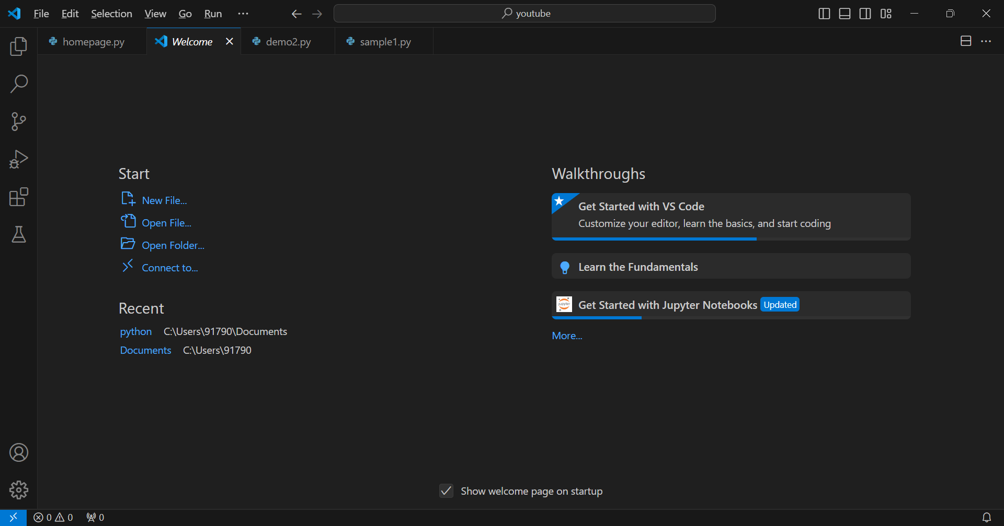
Tools Install

Slide 7
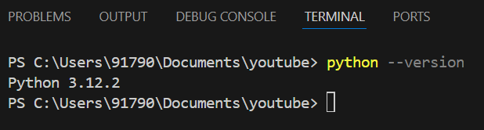
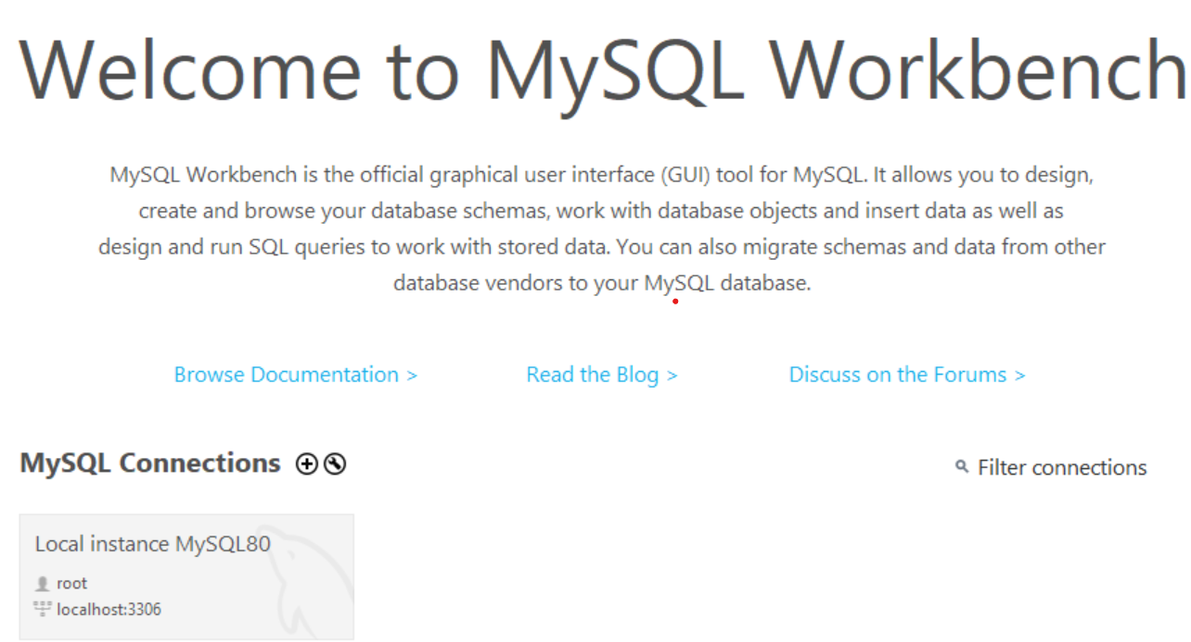
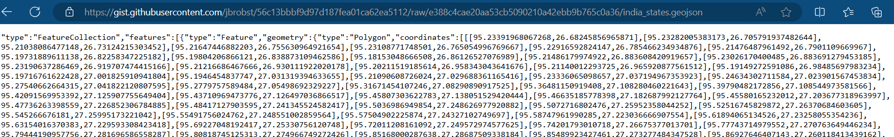
Python 3.12.2 or higher:
2.Python Version
MySQL:
To clone the GitHub repository:
3.MYSQL Home page
4.Getting geojson file from the git hub link

Slide 8

Requirement Libraries to Install
pip install request
pip install mysql-connector-python
Pip install git
pip install pandas
pip install streamlit
Pip install json
Pip install matplotlib.pyplot

Slide 9
Import Libraries
#pandas, numpy and file handling libraries
import os
import pandas as pd
import json
#Dashboard Libraries
import streamlit as st
import plotly.express as px
import matplotlib.pyplot as plt
import plotly.express as px
from streamlit_option_menu import option_menu
import PIL
from PIL import Image
import plotly.graph_objects as go
#Clone Libraries
import git
import requests
#SQL Libraries
import mysql.connector as sql

Slide 10
Extract Data
Clone the Github using scripting to fetch the data from the Phonepe pulse Github repository and store it in a suitable format such as JSON.Initially, we Clone the data from the Phonepe GitHub repository by using Python libraries.
"https://gist.githubusercontent.com/jbrobst/56c13bbbf9d97d187fea01ca62ea5112/raw/e388c4cae20aa53cb5090210a42ebb9b765c0a36/india_states.geojson”
Data Transformation
In this step the JSON files that are available in the folders are converted into the readable and understandable DataFrame format by using the for loop and iterating file by file and then finally the DataFrame is created. In order to perform this step I've used **os**, **json** and **pandas** packages. And finally converted the dataframe into CSV file and storing in the local drive.
This converts a given string into a dictionary which allows you to access your JSON data easily within my code
The JSON data and print that data same as we access the keys and values of a dictionary.

Slide 11
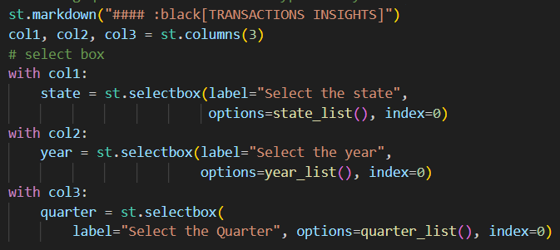
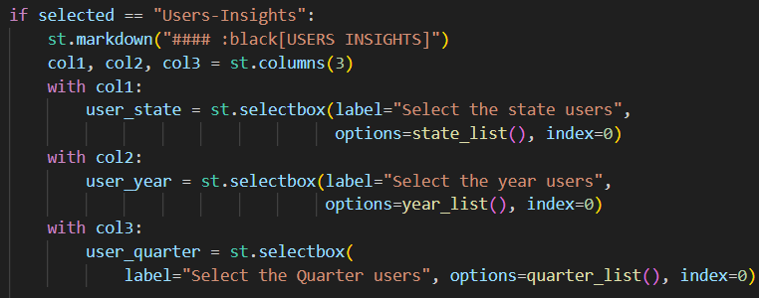
Insights
Transactions-Insights:
showing quarter wise financial type
wise year wise transaction for states.
Users-Insights:
showing quarter user wise financial type wise year wise user for states.

Slide 12
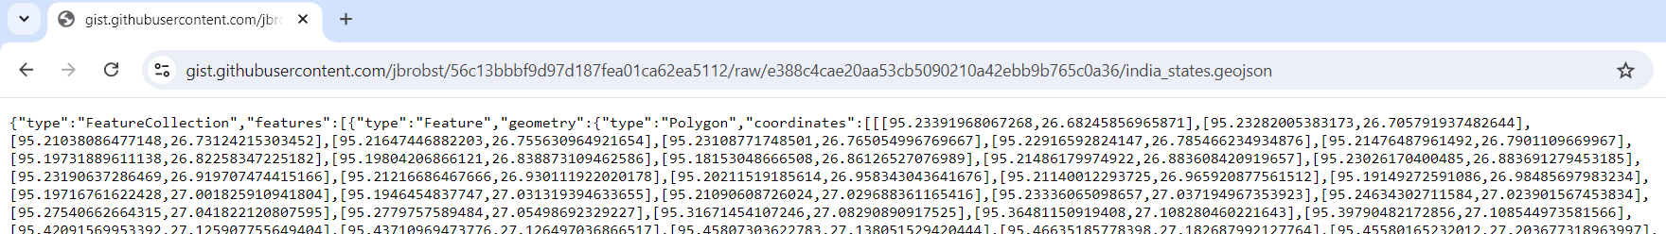
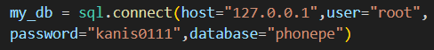
Exploratory Data Analysis
Access MySQL DB
Create a connection to the MySQL server and access the specified MySQL DataBase.
Clone the data from Github repository
Clone the data from the Phonepe GitHub repository by using Python libraries
Visulization
Finally, create a Dashboard by using Streamlit.
I am using bobble plot and bar chart for transaction insights and user insights of phonepe.

Slide 13
DASHBOARD CREATION
THE MAIN COMPONENTS OF DASHBOARD ARE
GEO-VISUALIZATION
TRANSACTIONS ANALYSIS
USERS ANALYSIS
TOP STATES DATA
Geo-Visualization:
The India map shows the Total Transactions of PhonePe in both state wide and District wide.
It comes with zoom option and on hover displays the content related to that particular state or district.
The main functions I have used to create this map are (User can give year and quarter input to show
how the data changed over time)
Transactions Analysis:
The Transactions data mainly contains the total Transactions count and total amount in each state and
district, I have used different graphs available in plotly to represent this data.
1 State-wise study:The above bar graph shows the increasing order of PhonePe Transactions
according to the states of India, Here we can observe the top states with the highest Transaction by
looking at graph.
2 District-wise study: User can observe how transactions are happening in districts of a selected
state. We can observe the leading distric in a state
3 Year-wise study: We can observe the states with total transactions in particular mode in the selected year
4 Overall Analysis:To show how the transactions drastically increased with time

Slide 14
Continue:
User Data Analysis:
The Users data mainly contains the Registered Users count and App openings via different mobile brands in each state and district,I have used different graphs available in plotly to represent this data.
1 State-wise study: User can observe how the App Openings are growing and how Registered users are growing in a state.
2 District-wise study: User can observe how App Openings are happening in districts of a selected state.
3 Year-wise study: User can observe the top leading brands in a particular state in given year.
4 Overall Analysis: We can see that the Registered Users and App openings are increasing year by year.
Top States Data:
1 States with top Registered users
2 States with top Total Amount Transacted
3 States with highest Transactions count
4 States with top app openings

Slide 15
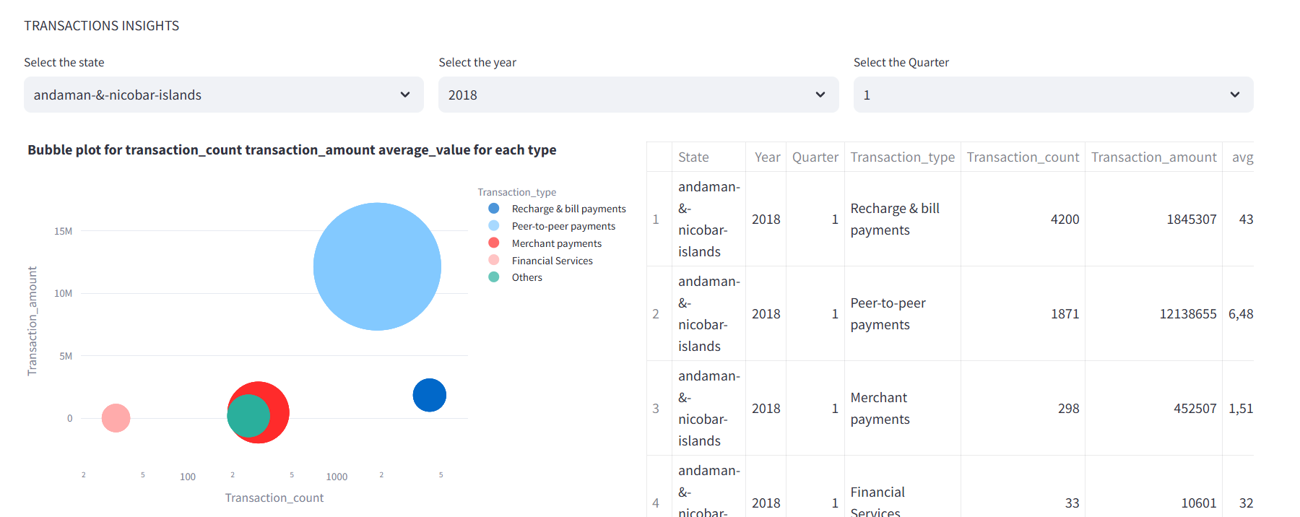
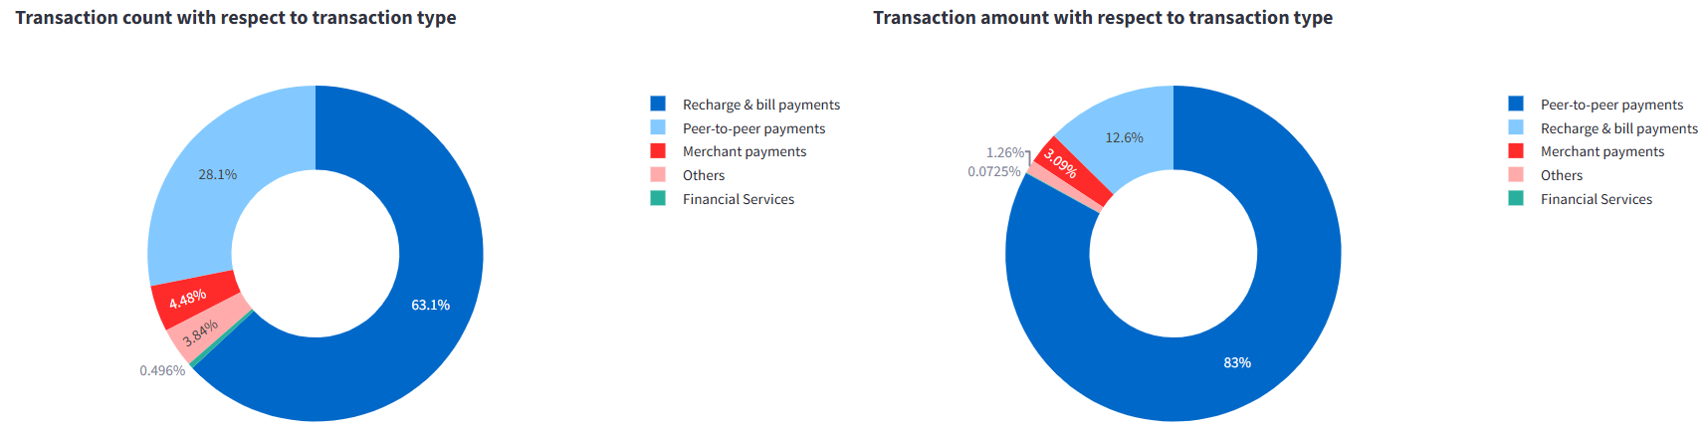
Transaction Insights Visualization:
[Transaction insights using bobble plot]
[Transaction insights using pie chart]
I am using bobble plot for visualization.
I Select the Andaman State and year of 2018 in first Quarter.
The result is Recharge&Bill payment is High Transaction.
I am using pie chart for Transaction count with to transaction type. The result is Recharge&Bill payment is High
Transaction count and amount.

Slide 16
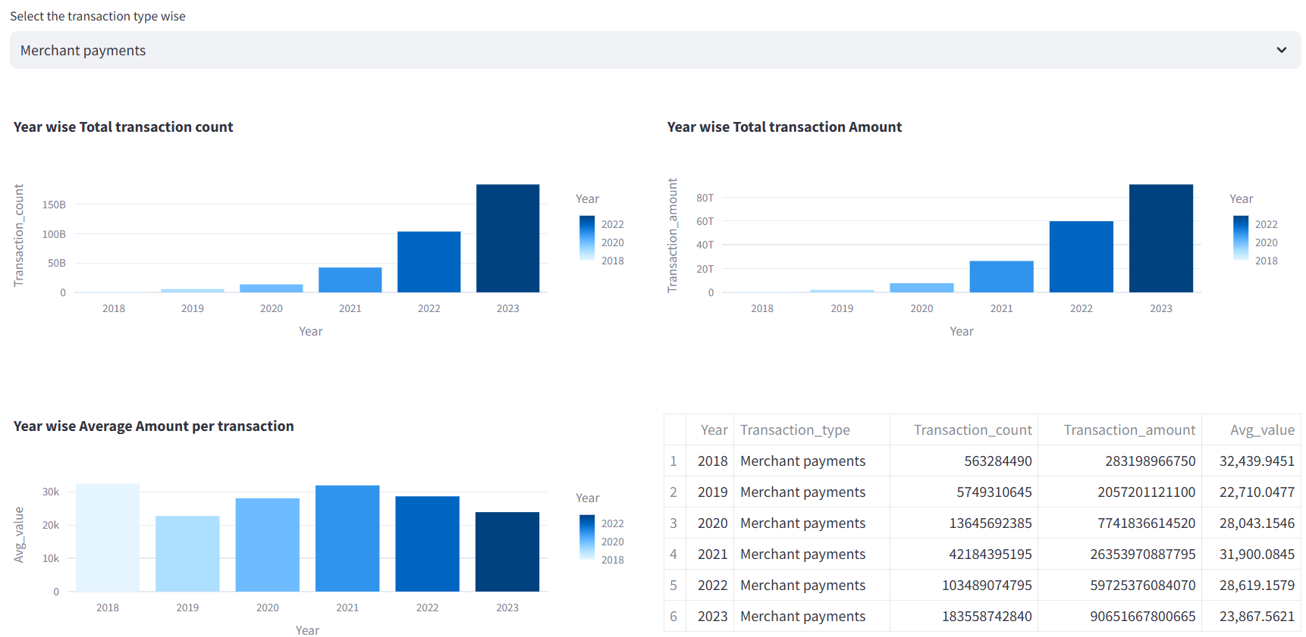
Transaction type wise Analysis:
Transaction type wise Analysis
The transaction type wise means merchant payment wise showing the result of year wise total transaction count and amount.
Year wise average amount per transaction compare with average value of 2018 to 2023. Merchant payments is high on 2018th year.

Slide 17
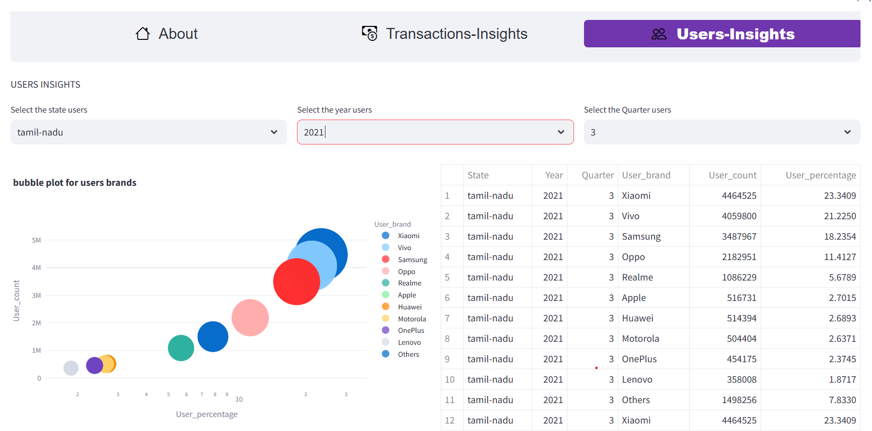
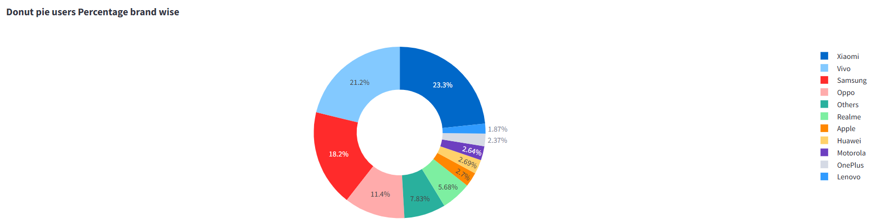
User Insights
[User insights using bobble plot]
[User insights using pie chart]
I am using bobble plot for User brands. I Select the Andaman State and year of 2021 in 3rd Quarter. The result is xiaomi is High user count and percentage.
I am using pie chart for brand wise count
with user .The result is xiaomi is High user
percentage.

Slide 18
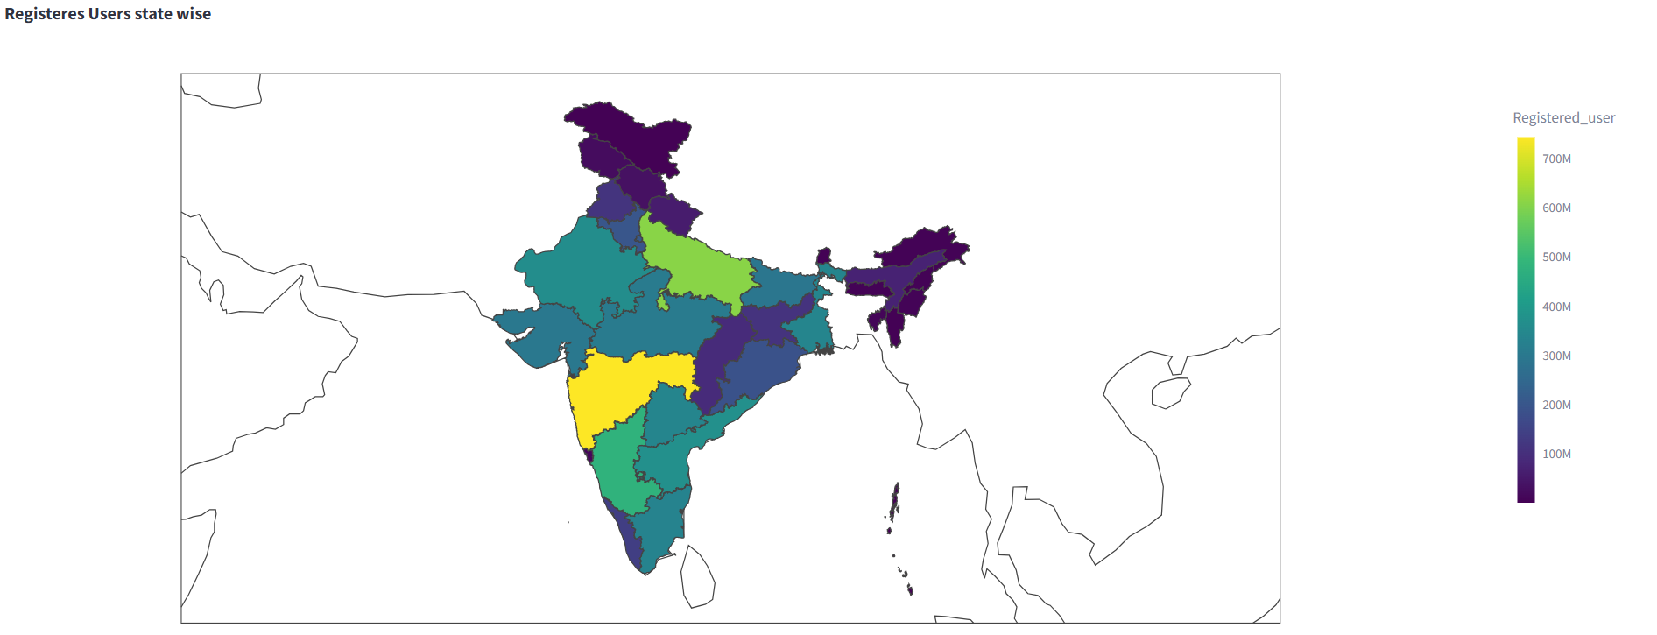
User wise Analysis
User wise Analysis in the year of 2023

Slide 19
Links
Video Link:
kanis11/kanimozhi: youtubedataharwesting (github.com)
https://www.linkedin.com/feed/update/urn:li:ugcPost:7201925977042558976/
GitHub Link:
kanimozhi/Homepage.png at main · kanis11/kanimozhi (github.com))
L

Slide 20

SUMMARY
- The result of this project is a live geo visualization dashboard that displays information and insights from the Phonepe Pulse GitHub repository in an interactive and visually appealing manner.
- The dashboard provides at least 10 different dropdown options for users to select various facts and figures for display.
- The data is efficiently stored in a MySQL database and is dynamically updated to reflect the latest data.
- Users can access the dashboard from a web browser and easily navigate the different visualizations and facts and figures displayed.
- The dashboard provides valuable insights and information about the data in the Phonepe Pulse GitHub repository, making it a valuable tool for data analysis and decision-making.

Slide 21
Thank You

